Slide 1
Understanding Groups and Teams
Chapter
15

Slide 2
L E A R N I N G O U T L I N E
Follow this Learning Outline as you read and study this chapter.
Understanding Groups
  Define the different types of groups.
  Describe the five stages of group development.
Explaining Work Group Behavior
  Explain the major components that determine group performance and satisfaction.
  Discuss how roles, norms, conformity, status systems, group size, and group cohesiveness influence group behavior.
  Explain how group norms can both help and hurt an organization.
  Define groupthink and social loafing.

Slide 3
L E A R N I N G O U T L I N E (cont’d)
Follow this Learning Outline as you read and study this chapter.
Explaining Work Group Behavior (cont’d)
  Describe the relationships between group cohesiveness and productivity.
  Discuss how conflict management influences group behavior.
  Tell the advantages and disadvantages of group decision making.
Creating Effective Teams
  Compare groups and teams.
  Explain why teams have become so popular in organizations.
  Describe the four most common types of teams.

Slide 4
L E A R N I N G O U T L I N E (cont’d)
Follow this Learning Outline as you read and study this chapter.
Creating Effective Teams (cont’d)
  List the characteristics of effective teams.
Current Challenges in Managing Teams
  Discuss the challenges of managing global teams
  Explain the role of informal (social) networks in managing teams.

Slide 5
Understanding Groups
Group
  Two or more interacting and interdependent individuals who come together to achieve specific goals.
  Formal groups
    Work groups defined by the organization’s structure that have designated work assignments and tasks.
      Appropriate behaviors are defined by and directed toward organizational goals.
  Informal groups
    Groups that are independently formed to meet the social needs of their members.

Slide 6
Exhibit 15–1 Examples of Formal Groups
Command Groups
  Groups that are determined by the organization chart and composed of individuals who report directly to a given manager.
Task Groups
  Groups composed of individuals brought together to complete a specific job task; their existence is often temporary because once the task is completed, the group disbands.

Slide 7
Exhibit 15–1 Examples of Formal Groups (cont’d)
Cross-Functional Teams
  Groups that bring together the knowledge and skills of individuals from various work areas or groups whose members have been trained to do each others’ jobs.
Self-Managed Teams
  Groups that are essentially independent and in addition to their own tasks, take on traditional responsibilities such as hiring, planning and scheduling, and performance evaluations.

Slide 8
Stages in Group Development
Forming
  Members join and begin the process of defining the group’s purpose, structure, and leadership.
Storming
  Intragroup conflict occurs as individuals resist control by the group and disagree over leadership.
Norming
  Close relationships develop as the group becomes cohesive and establishes its norms for acceptable behavior.
Performing
  A fully functional group structure allows the group to focus on performing the task at hand.
Adjourning
  The group prepares to disband and is no longer concerned with high levels of performance.

Slide 9
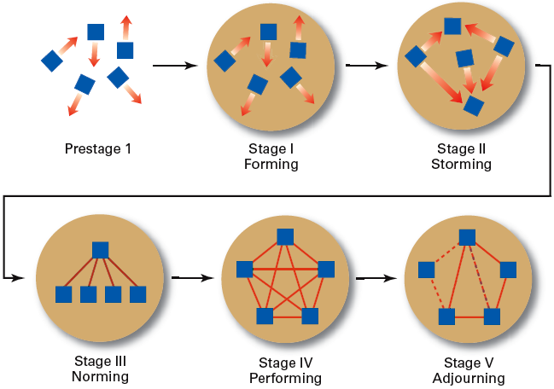
Exhibit 15–2 Stages of Group Development

Slide 10
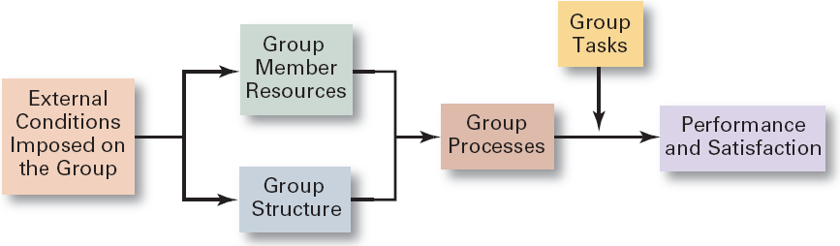
Exhibit 15–3 Group Behavior Model

Slide 11
Work Group Behavior
Internal Variables Affecting Group Behavior
  The individual abilities of the group’s members
  The size of the group
  The level of conflict
  The internal pressures on members to conform to the group’s norms

Slide 12
Conditions Affecting Group Behavior
External (Organizational) Conditions
  Overall strategy
  Authority structures
  Formal regulations
  Available organizational resources
  Employee selection criteria
  Performance management (appraisal) system
  Organizational culture
  General physical layout
Internal Group
Variables
  Individual competencies and traits of members
  Group structure
  Size of the group
  Cohesiveness and the level of intragroup conflict
  Internal pressures on members to conform o the group’s norms

Slide 13
Group Structure
Role
  The set of expected behavior patterns attributed to someone who occupies a given position in a social unit that assist the group in task accomplishment or maintaining group member satisfaction.
  Role conflict: experiencing differing role expectations
  Role ambiguity: uncertainty about role expectations

Slide 14
Group Structure (cont’d)
Norms
  Acceptable standards or expectations that are shared by the group’s members.
Common types of norms
  Effort and performance
    Output levels, absenteeism, promptness, socializing
  Dress
  Loyalty

Slide 15
Group Structure (cont’d)
Conformity
  Individuals conform in order to be accepted by groups.
  Group pressures can have an effect on an individual member’s judgment and attitudes.
  The effect of conformity is not as strong as it once was, although still a powerful force.
  Groupthink
    The extensive pressure of others in a strongly cohesive or threatened group that causes individual members to change their opinions to conform to that of the group.

Slide 16
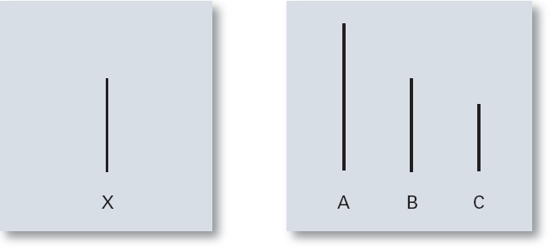
Exhibit 15–4 Examples of Cards Used in the Asch Study

Slide 17
Group Structure (cont’d)
Status System
  The formal or informal prestige grading, position, or ranking system for members of a group that serves as recognition for individual contributions to the group and as a behavioral motivator.
    Formal status systems are effective when the perceived ranking of an individual and the status symbols accorded that individual are congruent.

Slide 18

Group Structure: Group Size
Small groups
  Complete tasks faster than larger groups.
  Make more effective use of facts.
Large groups
  Solve problems better than small groups.
  Are good for getting diverse input.
  Are more effective in fact-finding.
Social Loafing
  The tendency for individuals to expend less effort when working collectively than when work individually.

Slide 19

Group Structure (cont’d)
Group Cohesiveness
  The degree to which members are attracted to a group and share the group’s goals.
    Highly cohesive groups are more effective and productive than less cohesive groups when their goals aligned with organizational goals.

Slide 20
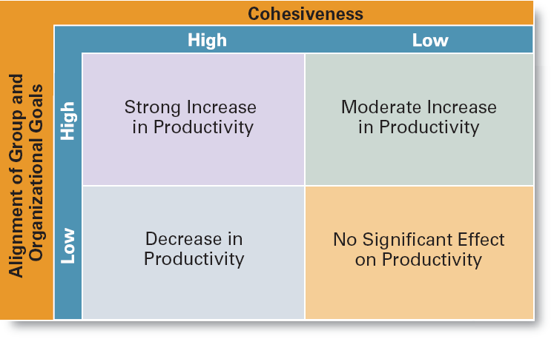
Exhibit 15–5 The Relationship Between Cohesiveness and Productivity

Slide 21
Group Processes: Group Decision Making
Advantages
  Generates more complete information and knowledge.
  Generates more diverse alternatives.
  Increases acceptance of a solution.
  Increases legitimacy of decision.
Disadvantages
  Time consuming
  Minority domination
  Pressures to conform
  Ambiguous responsibility

Slide 22
Exhibit 15–6 Group versus Individual Decision Making
Criteria of Effectiveness Groups Individuals
Accuracy ✓
Speed ✓
Creativity ✓
Degree of acceptance ✓
Efficiency ✓

Slide 23
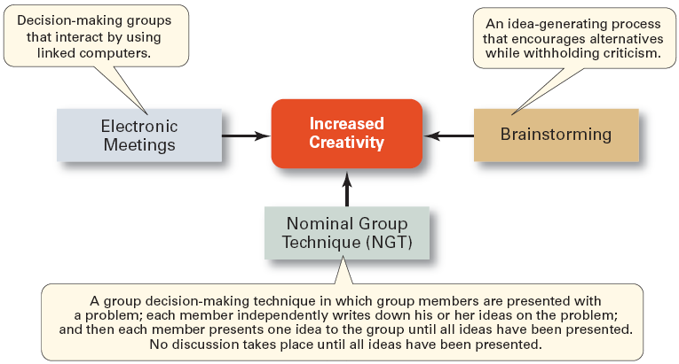
Exhibit 15–7 Techniques for Making More Creative Group Decisions

Slide 24
Group Processes: Conflict Management
Conflict
  The perceived incompatible differences in a group resulting in some form of interference with or opposition to its assigned tasks.
    Traditional view: conflict must be avoided.
    Human relations view: conflict is a natural and inevitable outcome in any group.
    Interactionist view: conflict can be a positive force and is absolutely necessary for effective group performance.

Slide 25
Group Processes: Conflict Management (cont’d)
Categories of Conflict
  Functional conflicts are constructive.
  Dysfunctional conflicts are destructive.
Types of Conflict
  Task conflict: content and goals of the work
  Relationship conflict: interpersonal relationships
  Process conflict: how the work gets done

Slide 26
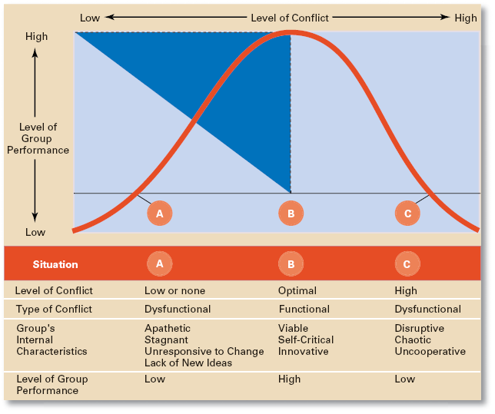
Exhibit 15–8 Conflict and Group Performance

Slide 27
Group Processes: Conflict Management (cont’d)
Techniques to Reduce Conflict:
  Avoidance
  Accommodation
  Forcing
  Compromise
  Collaboration

Slide 28
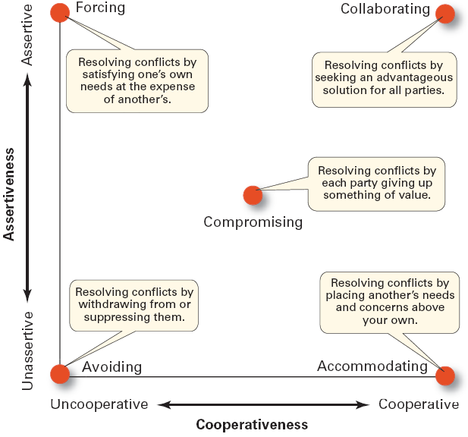
Exhibit 15–9 Conflict-Management Techniques
Source: Adapted from K.W. Thomas, “Conflict and Negotiation Processes in Organizations,” in M.D. Dunnette and L.M. Hough (eds.) Handbook of Industrial and Organizational Psychology, vol. 3, 2d ed. (Palo Alto, CA: Consulting Psychologists Press, 1992), p. 668. With permission

Slide 29
Group Tasks and Group Effectiveness
Highly complex and interdependent tasks require:
  Effective communications: discussion among group members.
  Controlled conflict: More interaction among group members.

Slide 30
What Is a Team?
Work Team
  A group whose members work intensely on a specific common goal using their positive synergy, individual and mutual accountability, and complementary skills.
Types of Teams
  Problem-solving teams
  Self-managed work teams
  Cross-functional teams
  Virtual teams

Slide 31
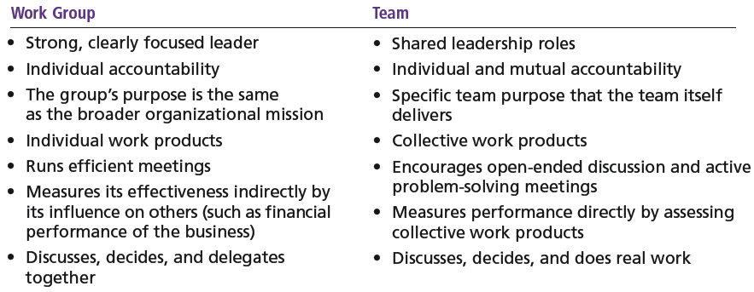
Exhibit 15–10 Groups versus Teams

Slide 32
Types of Teams
Problem-solving Teams
  Employees from the same department and functional area who are involved in efforts to improve work activities or to solve specific problems.
Self-managed Work Teams
  A formal group of employees who operate without a manager and responsible for a complete work process or segment.

Slide 33
Types of Teams (cont’d)
Cross-functional Teams
  A hybrid grouping of individuals who are experts in various specialties and who work together on various tasks.
Virtual Teams
  Teams that use computer technology to link physically dispersed members in order to achieve a common goal.

Slide 34

Advantages of Using Teams
Teams outperform individuals.
Teams provide a way to better use employee talents.
Teams are more flexible and responsive.
Teams can be quickly
assembled, deployed,
refocused, and disbanded.

Slide 35
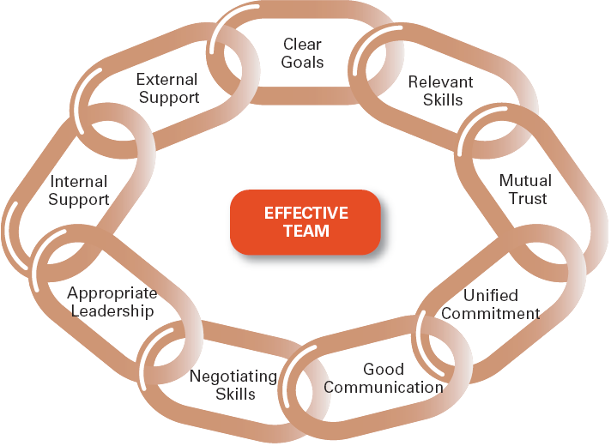
Exhibit 15–11 Characteristics of Effective Teams

Slide 36
Characteristics of Effective Teams
Have a clear understanding of their goals.
Have competent members with relevant technical and interpersonal skills.
Exhibit high mutual trust in the character and integrity of their members.
Are unified in their commitment to team goals.
Have good communication systems.
Possess effective negotiating skills
Have appropriate leadership
Have both internally and externally supportive environments

Slide 37

Current Challenges in Managing Teams
Getting employees to:
  Cooperate with others
  Share information
  Confront differences
  Sublimate personal interest for the greater good of the team

Slide 38
Managing Global Teams
Group Member Resources
  Unique cultural characteristics of team members
  Avoiding stereotyping
Group Structure
  Conformity—less groupthink
  Status—varies in importance among cultures
  Social loafing—predominately a Western bias
  Cohesiveness—more difficult to achieve
Group processes—capitalize on diverse ideas
Manager’s role—a communicator sensitive to the type of globe team to use.

Slide 39
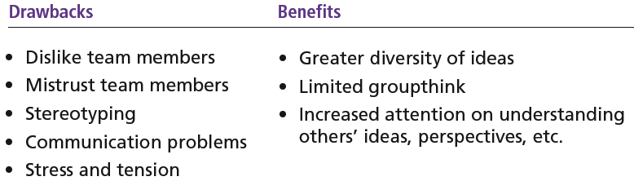
Exhibit 15–12 Drawbacks and Benefits of Global Teams

Slide 40

Understanding Social Networks
Social Network
  The patterns of informal connections among individuals within groups
The Importance of Social Networks
  Relationships can help or hinder team effectiveness
  Relationships improve team goal attainment and increase member commitment to the team.

Slide 41
Terms to Know
group
forming
storming
norming
performing
adjourning
role
norms
groupthink
status
social loafing
group cohesiveness
conflict
traditional view of conflict
human relations view of conflict
interactionist view of conflict
functional conflicts
dysfunctional conflicts
task conflict
relationship conflict
process conflict
work teams

Slide 42
Terms to Know
problem-solving team
self-managed work team
cross-functional team
virtual team
social network structure

